Slide 1
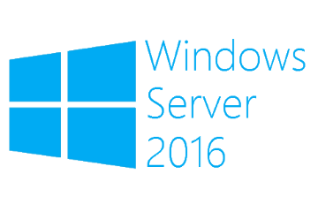
Demote a Windows Server 2016 Core Domain Controller
Megaseries

Slide 2
Steps
Demote the DC
Remove the former DC from the domain
Delete the computer object from AD
Delete the server container from the Site it was in
Delete the VM along with its HDD

Slide 3

https://www.youtube.com/channel/UCcZ-jLbPwNr8E_v9-65n8Iw https://github.com/itknowledge4

